Slide 1
Patient Generated Health Data in Ireland: A Study of the Patient Perspective
by Katie O’Rourke (2017)
Research Methods
Group-I
Ashutosh Sharma (18304203)
Roman Shaikh (18300989)
Udita Retharekar (18301733)
Sahir Sharma (18303468)
Swastik Sahu (18303449)
Date 13/11/2018

Slide 2
Research Question
“To investigate the experiences, views and expectations of a cohort of individuals living with a chronic disease, with respect to the capture and sharing of patient generated health data.”
Source :O'Rourke, Katie (2016/17)
M.Sc. in Health Informatics
"Patient Generated Health Data in Ireland: A Study of the Patient Perspective"
Notes:
Performed a thorough literature review which helped the research to formulate the research question.
Researcher is motivated by internet penetration and technological advancements.

Slide 3
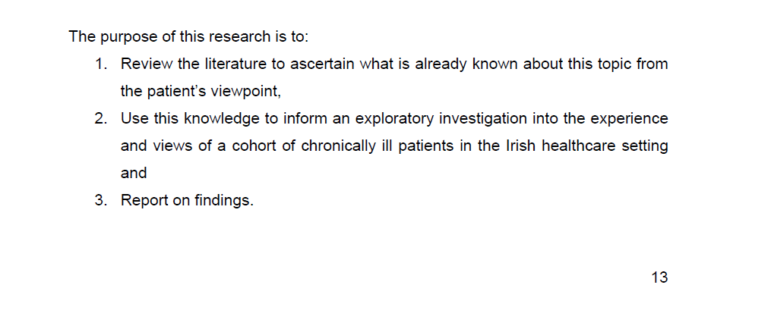
Few of the research aims mentioned
Image Source : O'Rourke, Katie (2016/17)
M.Sc. in Health Informatics
"Patient Generated Health Data in Ireland: A Study of the Patient Perspective"
Notes:
Initial aims, as defined by the researcher.

Slide 4
Research Aims
Study patient's perspective on PGHD (Patient Generated Health Data) in Ireland
Study aspects like - willingness, expectation, motivation, concerns from a patient's point of view
How PGHD can be incorporated into patient’s treatment
Review the available literature on PGHD
Target a wide range of chronic diseases for study of PGHD
Study role of technology in collecting and sharing PGHD, study the awareness among patients about the use of such technology
Report on all findings
* Source: https://www.irishtimes.com/business/personal-finance/have-the-irish-given-up-on-owning-their-own-homes-1.3005440
**Source: http://hea.ie/assets/uploads/2018/01/03627-HEA-FactsFigs-1617-Proof12-Poster-005.pdf
*** TCD website
Notes:
Role of PGHD has been studied mostly from Doctors or medical institute’s perspective.
Very little research has been done from a patient perspective
Aim of research was to find patients sentiments regarding use of PGHD and how it can be collected and used for their own benefit.
Researcher thinks that these advancements in technology have enormous possibilities to influence healthcare delivery.
Researcher also aim to understand people perspective on PGHD.
Researcher also finds that in the current system doctors do not look at the PGHD, and it is not considered significantly important.
Thus, this research could provide importance of PGHD to the complete healthcare ecosystem.

Slide 5
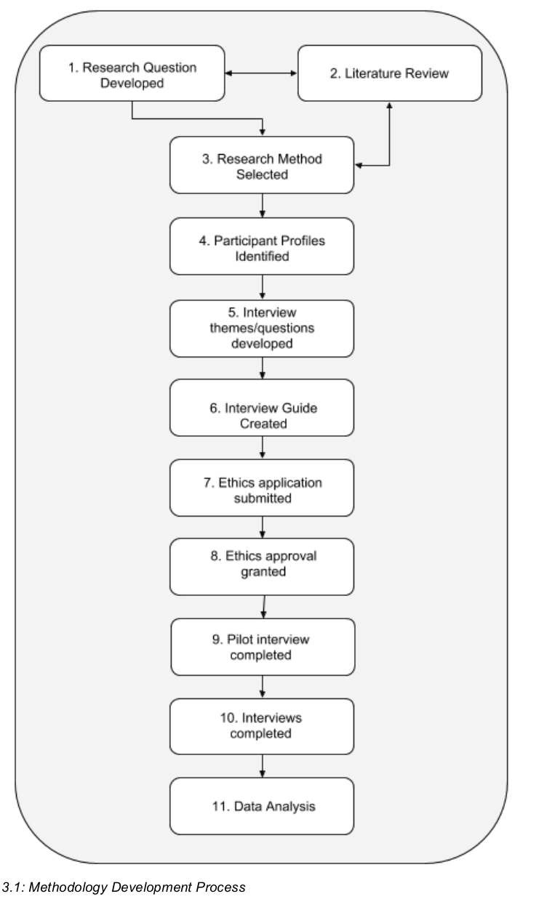
Design plan
Literature review
Ethics approval (9.5 weeks!)
Participant recruitment process Opportunistic/Convenience methods
Interview structure Exploratory, Evolving with time
Data Analysis Hybrid deductive-inductive approach Identification & Clustering of themes
Image Source : O'Rourke, Katie (2016/17)
M.Sc. in Health Informatics
"Patient Generated Health Data in Ireland: A Study of the Patient Perspective"
Notes:
Sampled people from different diseases.
Sample size : initially estimated 10 as considered achievable.
Inclusion criteria :
Participants must be living with at least one chronic illness.
Participants must be living in Ireland and interacting with the Irish healthcare system.
Participants must be 18 years or older.
Participants must be capable of giving informed consent.
Ethics
Ethical Approval: Submission made to TCD. Granted in 9.4 weeks.
Ethical Considerations:
Data will be anonymised and stored securely.
Interview participants could request a copy of the study and findings once they were complete.
Informed consent
Data Analysis (qualitative research).

Slide 6
Criticism
Positives:
Provides a good base for future research from a patient perspective [also from doctor’s perspective, why PGHD is not studied by the institutes?]
The research scope was kept small but it was carried out in a structured manner
Provided references and cited them wherever needed
Negatives:
All the research aims mentioned initially were not fully addressed
Could have been planned better which could have resulted in more conclusive findings [Ethics application could have been applied earlier]
More questions could have been asked to gain insight on some findings [If the user is tech savvy or not] [Awareness/Opinion on mHealth apps] etc.
Notes:
Although the student has discussed the limitations of her research and tried to justify any gaps in her research, the aims mentioned were not entirely studied and findings not reported fully.
We think that researcher could have kept the initial research aims narrow and focused on getting more conclusive results
Good overall report structure and literature review

Slide 7
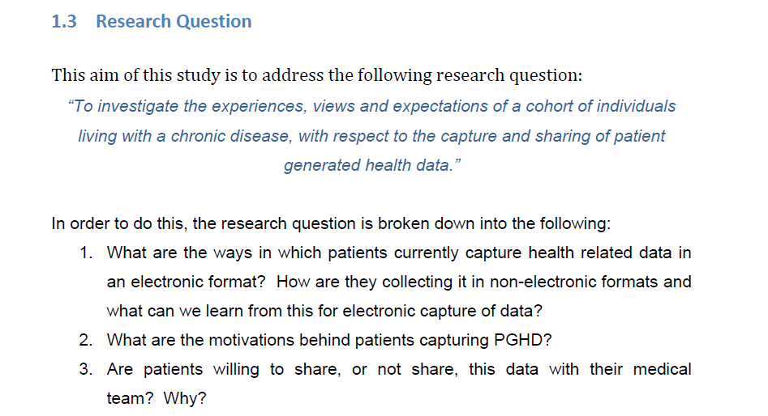
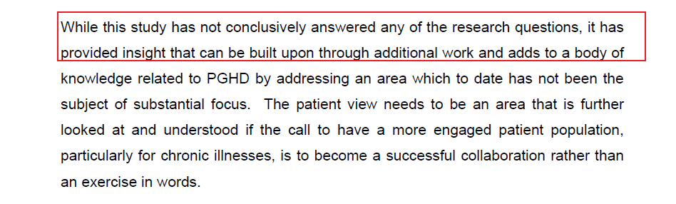
Initial research aims
Does not conclusively answer most questions presented above
Snippets from : O'Rourke, Katie (2016/17)
M.Sc. in Health Informatics
"Patient Generated Health Data in Ireland: A Study of the Patient Perspective"
Notes:
All the research aims mentioned were not completed conclusively

Slide 8
Improvements
Improve and scale recruitment process [Try to connect with several healthcare centres] [More focus on opportunistic/convenience methods]
Two set of interview questions: Short & Open-ended type [Depending on the interviewee’s mood]
User-group specific interview questions [age-specific, chronic disease specific]
Iterative interview cycles [Restructure questions based on results]
Notes:
2 sets of questions as student mentions that she couldn’t get a fruitful interview due to the interviewees grumpy mood. In such a scenario having a short questionnaire might help.
Student mentions that one interviewee who had a long history of disease never took PGHD seriously when he was young. Therefore age specific questions might help gain
Better understanding of PGHD awareness
Although the student conducted 9 interviews, she could have remodelled her interviews to gain more insights i.e. followed an iterative approach

Slide 9
Group Contribution
Each team member read the dissertation.
Each team member provided their individual insights and review of the paper which were later on consolidated during group discussions.
Each member contributed in the final presentation with each focusing on sections as mentioned below:
Swastik Sahu: Individual review, Criticism, Interview structure, PPT
Ashutosh Sharma: Individual review, Research Aims, Ethics, PPT
Roman Shaikh: Individual review, Improvements, Grammatical errors
Udita Retharekar: Individual review, Methodology/Design Plan, Citations
Sahir Sharma: Individual review, results and findings, PPT
Notes:
It was a combined team effort!

Slide 10
Any Questions?

Slide 11
Thank You

